Slide 1

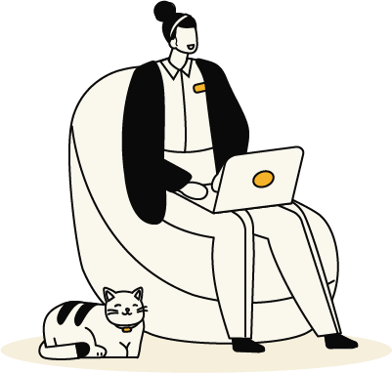
Saiqa Manzoor Advance Union

Slide 2


What we will talk about
About Unions
Who are Advance and what do we do?
Why is this session so important?
Our people and your union
All the benefits
What's in it for you?

Slide 3

What is a Union?
What is a Union?

Slide 4
Why Unions matter
Workplaces change — roles, structures, expectations.
- A union helps you navigate all of it.
You’re stronger with representation than without it.
When something feels unclear, unfair, or overwhelming, you have experts ready to step in.
“It’s not about problems — it’s about protection.”
Notes:
We are an independent, member-led union supporting Santander colleagues at every level.

Slide 5
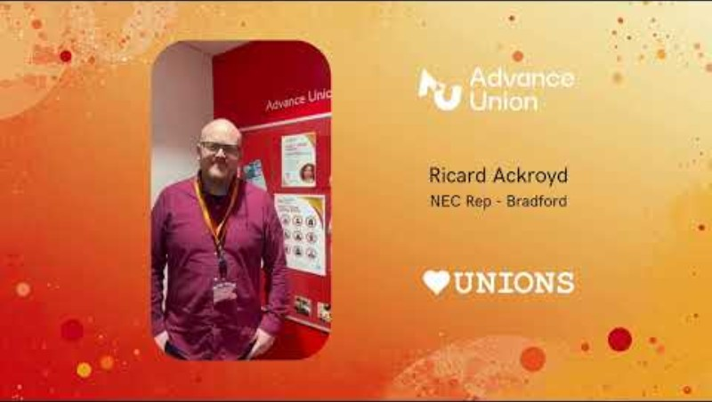
Why Unions matter
Notes:
We are an independent, member-led union supporting Santander colleagues at every level.

Slide 6
Who are Advance Union?
“The only union totally dedicated to people in
Santander by being “Your Informed Voice At Work”
Notes:
We are an independent, member-led union supporting Santander colleagues at every level.

Slide 7
Our purpose
Working together for our members
Ensuring fairness at work
Acting in strength for our members
Safeguarding you pay & benefits
Conserving your security of employment
Advocating Diversity, Equality & Inclusion

Slide 8
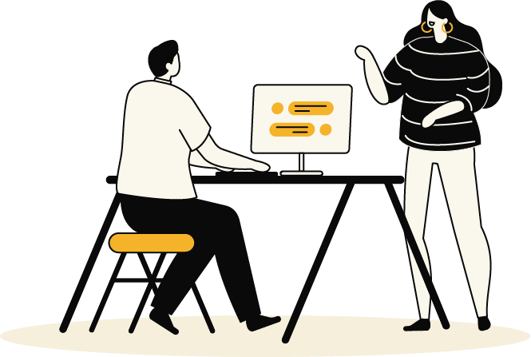
What does Advance do for members?
Help resolve concerns at work
Advice, support, members via the helpline,
on-line web chat
Advice and guidance
on policies, processes
and
workplace changes
Great benefits that
help
you save money
Be part of a wider community
through your workplace reps
Let your union know
what is important to
you on matters like pay
Local reps who know your site, your role, and your challenges
Notes:
Local reps who know your site, your role, and your challenges
Advice and guidance on policies, processes and workplace changes
Support during restructures, performance processes, and difficult conversations.
Local reps who know your site, your role and your challenges

Slide 9
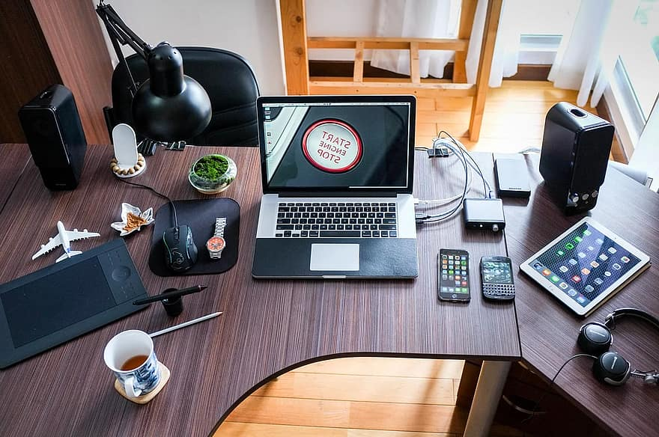
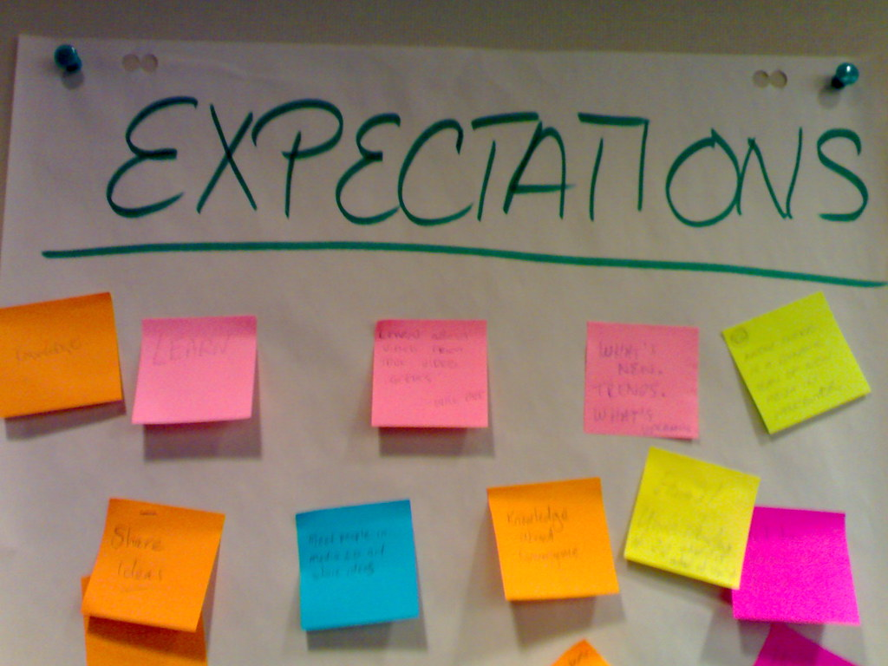



How we support New Joiners
Advance Union is here as a steady point of support while you settle in
If anything feels unclear or inconsistent, we’re here to guide you through it so you
feel confident and informed
We’re here to help you navigate
those early challenges
Advance Union gives you a confidential, judgment‑free space to ask anything — from “Is this normal?” to “What should I do next?” You’ll always get honest, supportive guidance
You don’t need to wait for a problem to join or reach out. Our support starts the
moment you walk through the door

Slide 10


Testimonials
“Being a member of Advance Union has given me confidence at work knowing that expert advice and representation are just a phone call away. Whether it’s guidance on a tricky work situation or support at a formal meeting, I’ve always felt backed by professionals who genuinely care about fair treatment.”
“I never expected how valuable the membership would be outside of work issues — from exclusive discounts and travel deals. The benefits alone have more than paid for my subscription, and that’s before even counting the peace of mind I get from union support.”
“Joining Advance Union has given me a real voice at work. Through meetings, open webinars, and collective representation, I feel like I’m making a difference and helping shape a better working experience for everyone. This community has made my day-to-day working life more positive.”
“Advance Union has a knowledgeable team that offers confidential advice and genuine support. I know I’m part of a professional community that stands up for its members, keeps us informed, and works constructively with employers for better pay, conditions and fairness.”

Slide 11




Great benefits for members

Slide 12
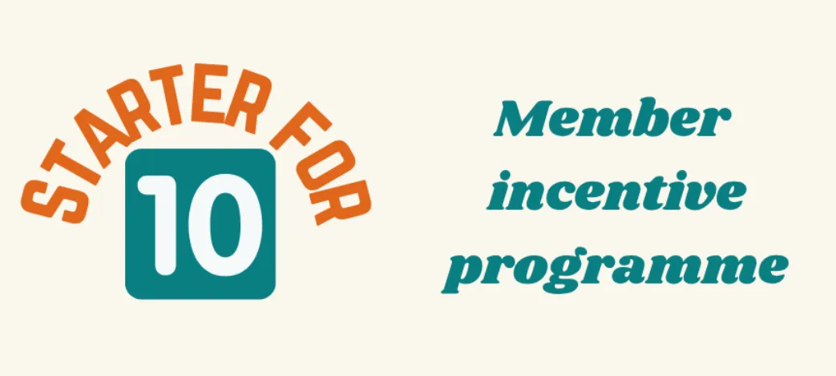
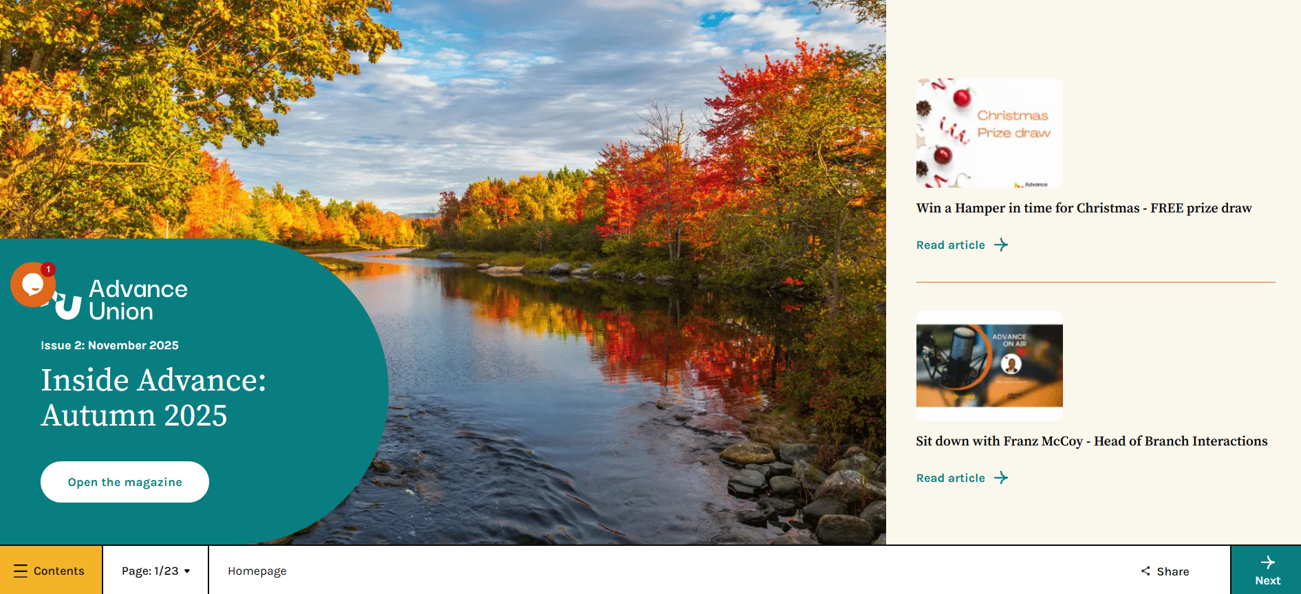

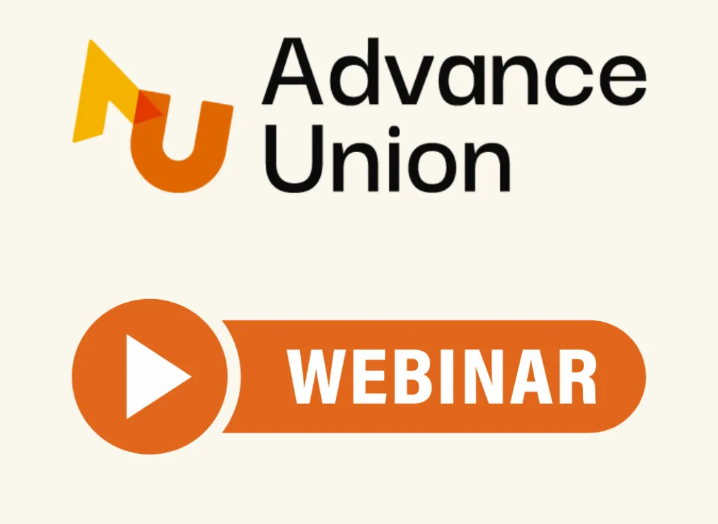
What else….
Quarterly newsletters
Competitions

Slide 13
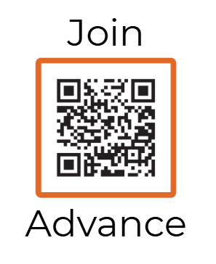
Join today….

Slide 14

Contact & Connect
Helpline: 01442 891122
info@advance-union.org
www.advance-union.org

