Slide 1


End of year ratings and appeals process rights- Your Rights

Slide 2
What we will talk about
About Unions
Who are Advance and what do we do?
Why is this session so important?
Our people and your union
All the benefits
What's in it for you?

Slide 3

What is a Union?
What is a Union?

Slide 4
Who are Advance Union?
“The only union totally dedicated to people in
Santander by being “Your Informed Voice At Work”

Slide 5
Our purpose
Working together for our members
Ensuring fairness at work
Acting in strength for our members
Safeguarding you pay & benefits
Conserving your security of employment
Advocating Diversity, Equality & Inclusion

Slide 6
What does Advance do for members?
Help resolve concerns at work
Advice, Support, members helpline, on-line web chat
Help resolve concerns at work
Be part of a wider community
through your workplace reps
Great benefits that help you save money
Let your union know what is important to you on matters like pay

Slide 7




Great benefits for members

Slide 8

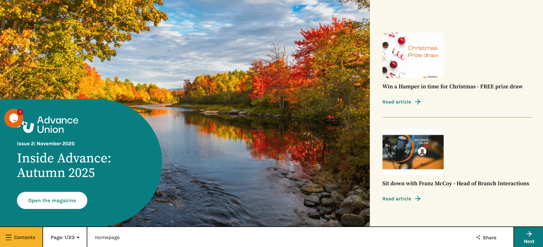


What else….
Quarterly newsletters
Competitions

Slide 9

Contact & Connect
Helpline: 01442 891122
info@advance-union.org
www.advance-union.org

Slide 10
Contact us

Slide 11
What does Advance do for members?

